Slide 1
NE 591 assignement : Journal article review and critique
Three dimensional coupled simulation of thermomechanics, heat, and oxygen diffusion in UO2 nuclear fuel rods
Authors: Chris Newman , Glen Hansen And Derek Gaston
Published in the journal of nuclear materials issue number 392 (2009) P6-15

Slide 3

Analytical coupled equations

Slide 4
Analytical coupled equations

Slide 5
Numerical resolution

Slide 10
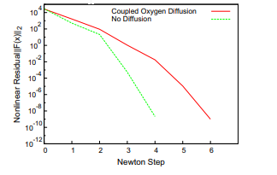
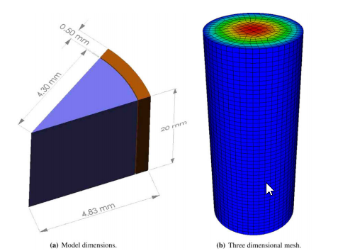
Article Critique
Evaluating the effectiveness of The JFNK
Comparing it’s result with the literature
Well structured and presented…
Many assumptions were made
Why this mesh. The effect of using another
Pictorial model
What could go wrong?
no Comparison of The JFNK approach to other
Algorithms
More of a evaluation of JFNK

Slide 11
Thank you for listening!

